Slide 1
Outline
WebEx and Zoom (Colin)
Impact
Important Considerations for online course delivery
Canvas resources
Content delivery
Assessment
Interactions
Development course

Slide 2
Impact
Lecture courses must be offered online
Many resources available in Canvas
Laboratory courses must be canceled
Alternate assignments may be provided during or after the two-week cancellation
Undergraduate research must be suspended
CH E 490 and Griswold Research Internships
Need to document revised expectations and deliverables
Graduate research and CTE/TA’s will continue
Leverage CTE/TA support to convert materials to online format

Slide 3
Important Considerations for Online Course Delivery
Internet access, tech savvy, and accessibility
Asynchronous delivery is preferred
Synchronous delivery must also be recorded
Minimize introduction of new software and web platforms
Direct students to available resources and tutorials for assistance with online tools (CELT Course Continuity)
Encourage students to communicate with SAS
Communication (required by March 23rd)
Clear expectations
Preferred method of communication
Additional course resources
Changes to assignments and deadlines

Slide 4
Important Considerations for Online Course Delivery
Effective, efficient, and flexible
Use technology with which you are already comfortable
Use available notes and PowerPoints
Use available web resources
Learn ChemE
Be flexible in the event that your access or student access to technology is limited

Slide 5
Canvas Resources
Content Delivery
Studio or WebEx
PowerPoint or scanned notes
Live lecture capture in Sweeney 1150
LiveScribe
Assessment
Quizzes/Surveys
Lockdown Browser
Assignments with file upload
Free pdf scanner apps available (CamScanner, Adobe Scan to PDF)
Library scanners available

Slide 6
Canvas Resources
Communication
Announcements
Discussions
Graded or ungraded
Anonymous (?)
Chat
Email

Slide 7
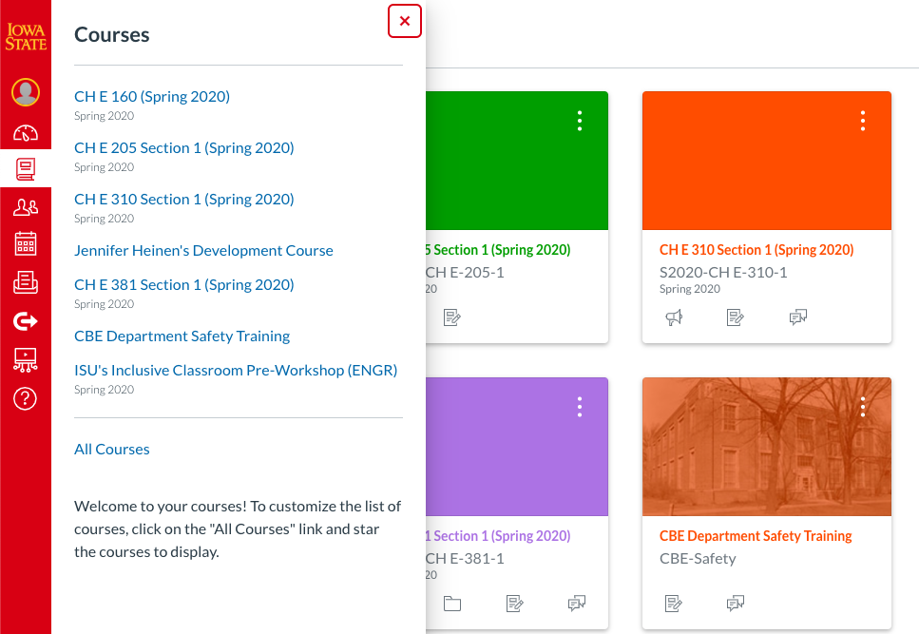
Canvas Resources: Development Course

Slide 8
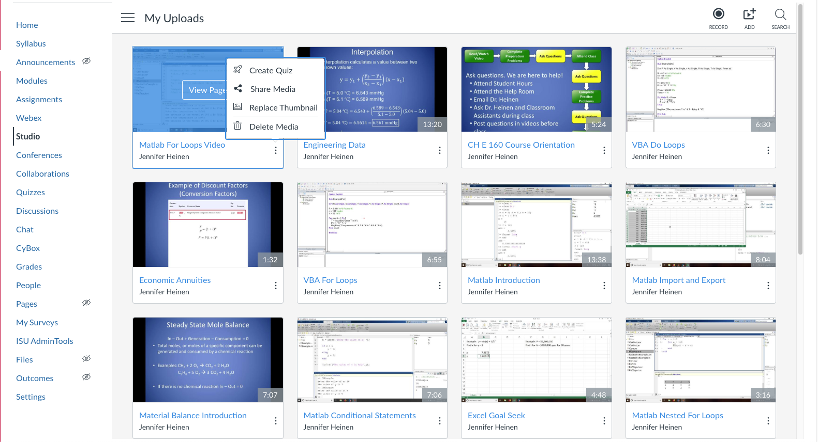
Studio
Add quizzes from My Uploads

Slide 9
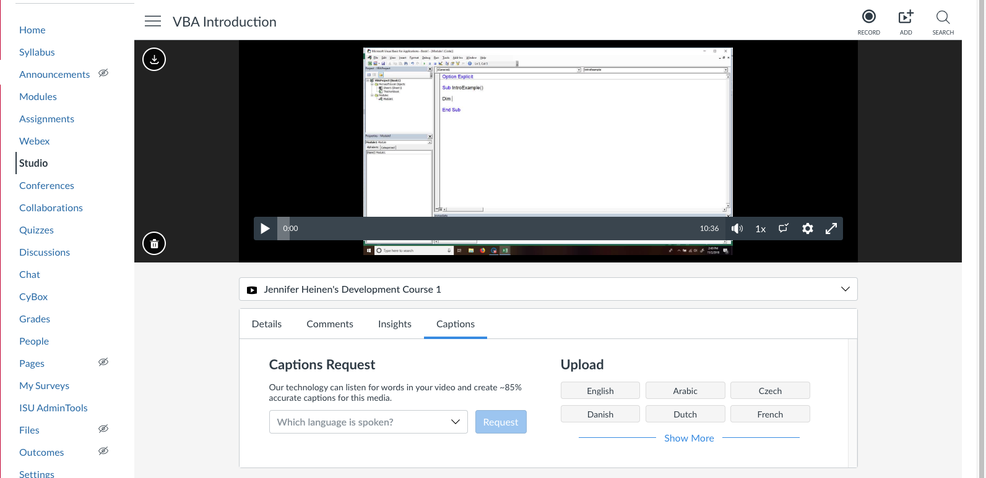
Studio Captions
Add caption from within video

